Slide 1
Machine Learning Inference on Mobile Phones
Anuj Dutt
Bose Corporation

Slide 3
Changes in Mobile Phone SoC Market over Years
CPU: Performs hundreds of thousands of calculations per second.
GPU: Uses multi-threading for doing multiple things in parallel, more speedup for specialized operations.
AI Processors: New SoC in the market. Specialized for running Neural Networks, faster at that than most GPU’s.

Slide 4
The need for AI Processors
Increased efficiency in three main areas:
a) Size
b) Computation
c) Energy
Examples: Apple’s Bionic Neural Engine, Huawei HiSilicon Kirin 980 etc.
Specialized SDK’s: Google Neural Network API, Qualcomm Snapdragon Neural Processing Engine SDK etc.
Image Source: https://www.androidauthority.com/smartphone-ai-processor-803019/

Slide 5
What does Machine Learning Inference on Mobile Phones Offer?

Slide 6
User Data Privacy
A hard job and a big onus lies upon the companies collecting the data.
Many instances available when privacy violations involve people who have been granted access to data.
Regulators across the world are approaching the data privacy concerns in different ways like the introduction of GDPR in EU, but is there something more that we can do?
Solution: Do as much processing as possible on the phone for ML applications.
This way user’s data never has to leave their mobile phone.

Slide 7
No Extra Data Cost
With every app solution on a mobile device there is an internet data cost associated with it.
First Data Cost: To download the application, specially the big ones.
Second Data Cost: App to Cloud API communication in the cloud.
Third Data Cost: Continuous streaming of data or uploading bulk data to cloud for processing or storage.

Slide 8
No Server Maintenance Cost
Machine learning model runs locally within the application on the mobile device, hence:
No server maintenance cost.
No compute cost [EC2 etc.]
No storage cost [S3]

Slide 9
Always Available Applications
Doing all the processing on the mobile phone means that your application will work always irrespective of whether you have an internet connection or not.
Hence, the users never have to see any downtime or app unavailability.

Slide 10
Real Time Inference
Running the model locally on-device means:
No Internet Latency.
No Bad Connection = Bad App Experience
No Application Downtime.

Slide 11
Mobile Machine Learning Recipe
ML Application = Efficient Pre-Trained Models + Efficient Mobile Inference Engine

Slide 12
Tools for Deploying ML Solutions on the Phone
Apple’s CoreML/CoreML 2 [iOS]
Google’s TFLite [Android/iOS]
Facebook’s Caffe2Go [Android/iOS]

Slide 13
Apple’s ML Ecosystem
2014 2016 2017 2018
Metal: low level and low overhead hardware accelerated 3D graphic and computer shader API.
BNNS: Basic Neural Network Subroutine ideal for Fully Connected Neural Networks
MPS: Metal Performance shaders, ideal for Convolution operations.
CoreML: Convert Pre-Trained or custom machine learning models in frameworks like TensorFlow, Keras, Scikit-Learn, PyTorch etc. to a format suitable for running in iOS applications.
CoreML 2: Convert and optimize models on the go for on-device application integration.

Slide 14
CoreML Architecture
Domain Specific Frameworks
ML Framework
ML Performance Primitives

Slide 15
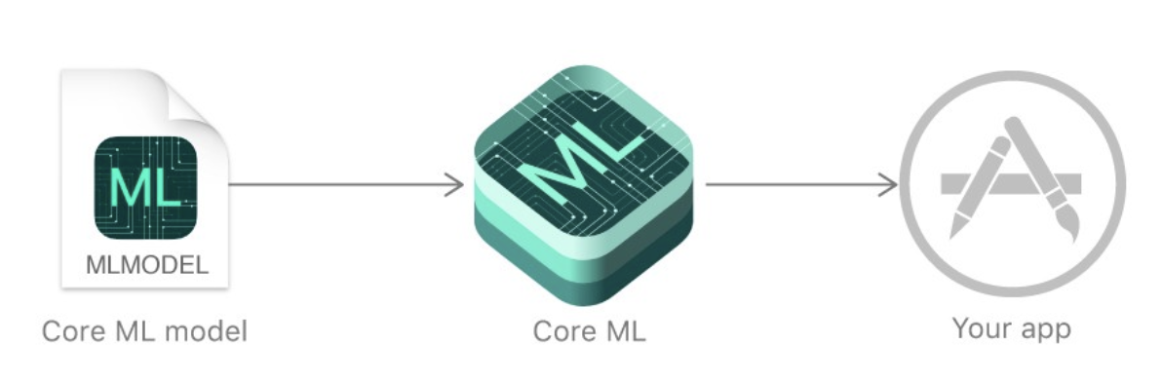
CoreML in Depth
CoreML supports Feed Forward NN, CNN’s, RNN’s, Tree Ensembles, SVM and Generalized linear Models.
The CoreML model contains a high level description of the machine learning model like the model weights, Input/Output types and structure of the network.
A CoreML model supports following input types:
Numerics, Categorical [Double, Int etc.]
Images as CVPixelBuffer
Arrays as MLMultiArray
Dictionaries
CoreML automatically takes care of hardware optimizations:
Compute heavy tasks are scheduled to run on the GPU or Neural Processing Engine.
Memory heavy tasks are scheduled to be run on Accelerate.
Auto-context switching from CPU to GPU and vice-versa for parts of the model.

Slide 16

CoreML Vision Framework
CoreML’s Vision framework is a specialized framework for applying computer vision algorithms to a variety of tasks involving image and video data.
Examples: Face recognition, face landmark detection, text detection, barcode recognition, image registration, and general feature tracking.
Vision also allows the use of custom Core ML models for tasks like classification or object detection.

Slide 17
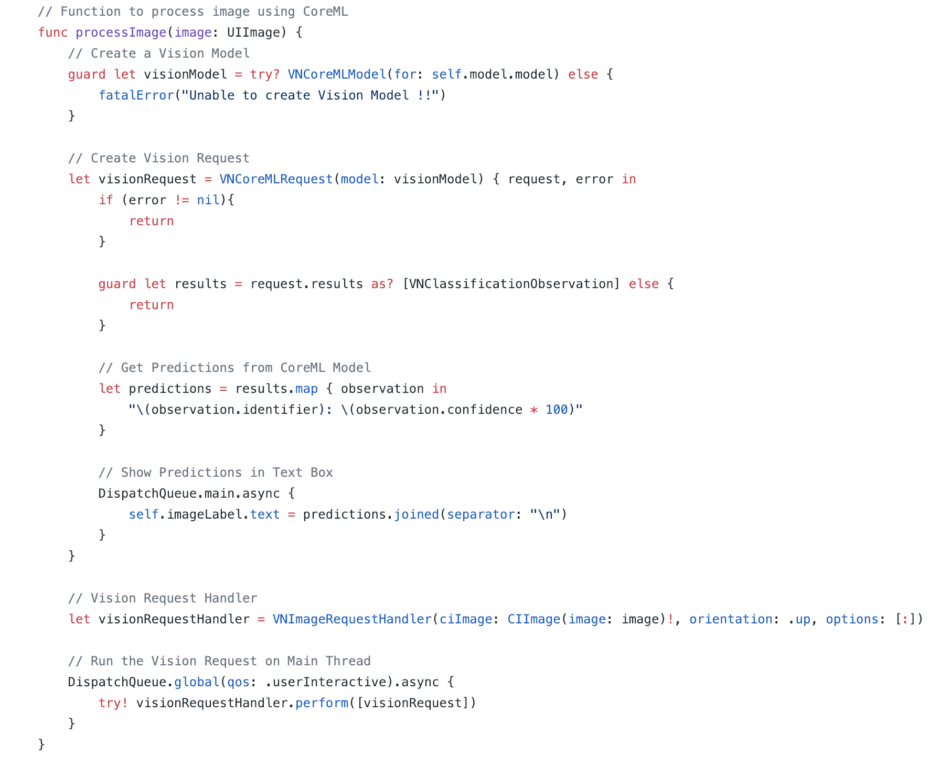
Using API’s from Vision Framework

Slide 18
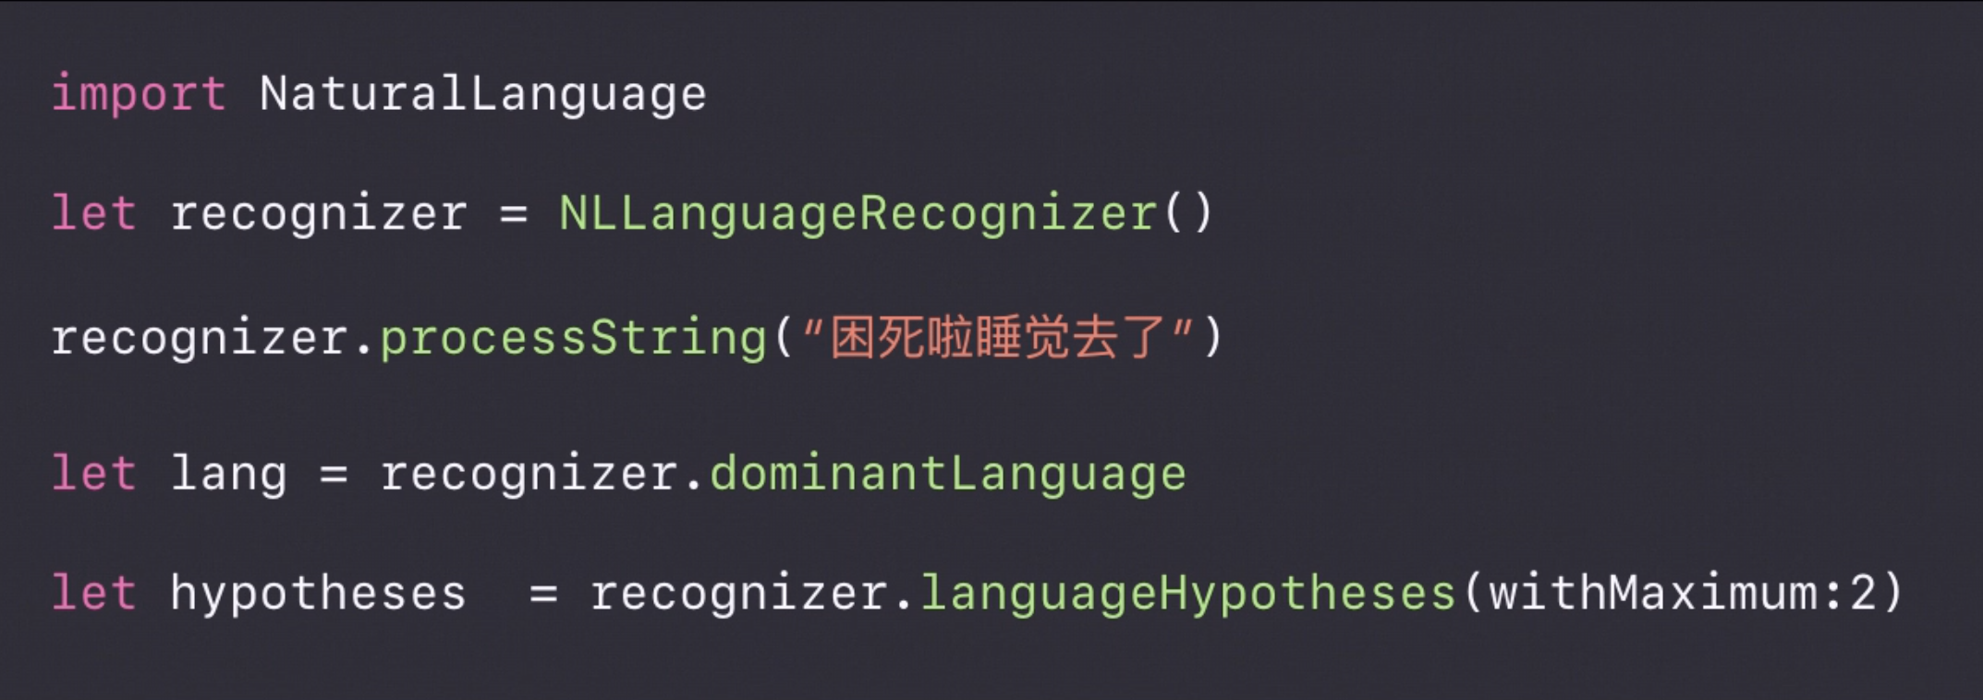
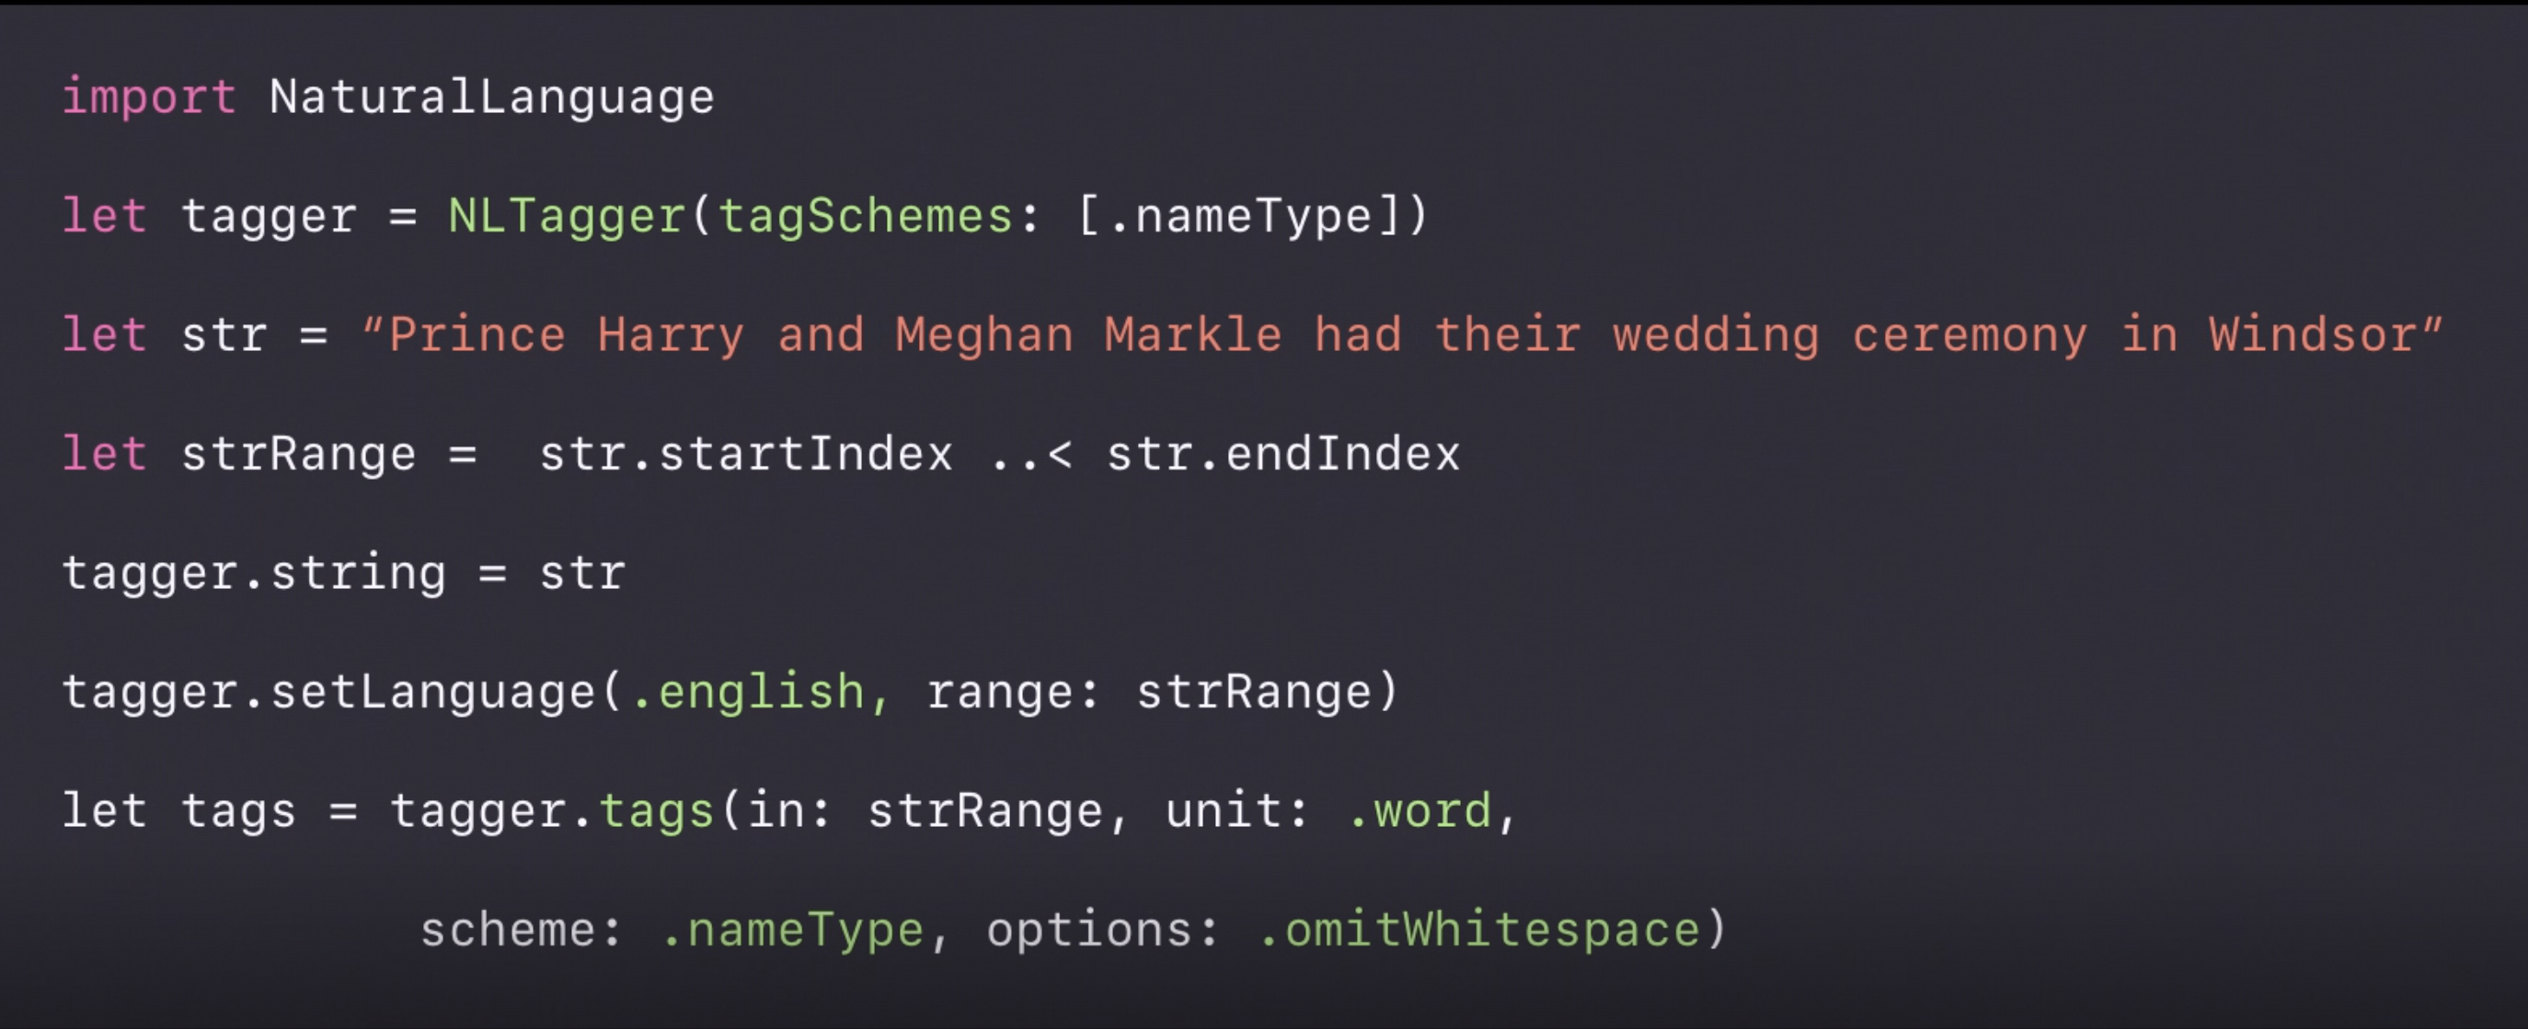
CoreML Natural Language Framework
Language Recognition
Word Tagging

Slide 19
CoreML Features
Weight Quantization: Reduced model and application size.
iOS 12 supports 8-bit, 4-bit unto 1-bit quantizations which reduces the model size drastically.
Note: Quantization might have an effect on your model accuracy. So, test for model accuracy after quantization and then decide if that decrease is acceptable for you or not, depending on your applications.
Batch Processing: Efficient processing of data in batches rather than looping through them.
Flexible Shapes: Pass in range of image or frame input size rather than defining a constant value.

Slide 20
CoreML 2: Weight Quantization

Slide 21
CoreML 2: Reduced Model Size

Slide 22
CoreML 2: Batch Processing

Slide 23
CoreML 2: Flexible Shapes

Slide 24
TFLite
Model’s Protobuf + Checkpoint to TFLite: Use existing TensorFlow API’s (toco scripts) to convert saved model files i.e. protobuf and checkpoint files to a TFLite model.
TFLite is a model file that contains the structure of the model as well as the weights and biases.
To run a TFLite model on Android, just deploy the model in an app and it’ll make use of Android’s ANN API to optimize the performance of the model.
For iOS, TFLite models use MPS to improve the performance of the model inference.

Slide 25
Saved ML Model to TFLite Format

Slide 26
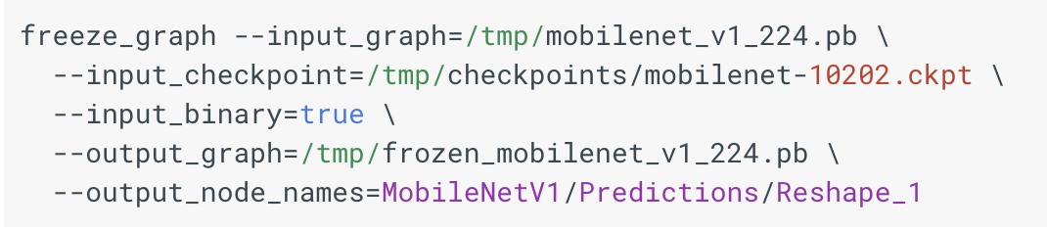
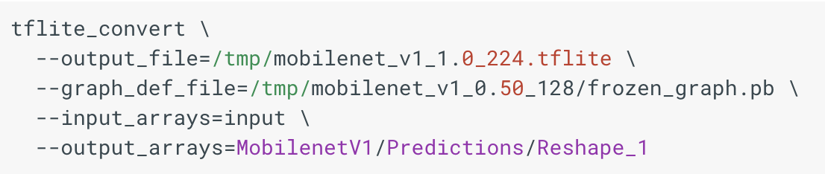
Using TFLite API
Freeze Graph using saved model [Protobuf + Checkpoint] :
Convert Frozen Graph to TFLite Model :

Slide 27
TFLite Features
TFLite Models: Smaller, faster and require minimal dependencies to run on an Android or an iOS device.
Low Memory Constraint: Requires around 75 KB of memory for the core interpreter, around 400 KB when combined with the supported operations.
TFLite takes advantage of hardware acceleration for faster inference. It makes use of Flat buffers that reduces the code footprint, memory usage, CPU cycles required for serialization and deserialization thereby improving the app startup time.
TFLite’s Interpreter uses static memory and static execution plan thereby reducing the load time.

Slide 28
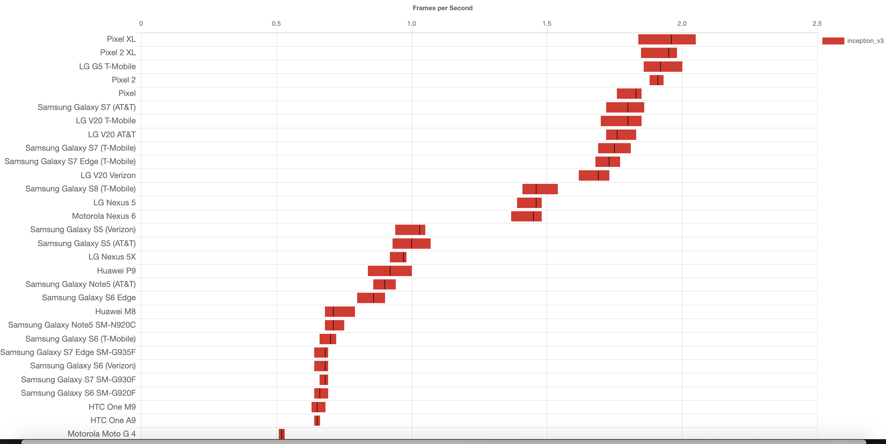
TFLite Benchmark for Inception V3

Slide 29
Caffe2
Caffe2: Deep Learning framework built by Facebook.
This framework is built for speed as it has built-in optimizations for different hardware architectures like:
For ARM based CPU, it makes use of NEON Kernels and NNpack which are acceleration packages for running neural networks on multi-core CPU.
For iOS devices, it makes use of MPSGraph and Metal libraries to speed up performance on the GPU.
For Android devices, it makes use of Qualcomm Snapdragon Neural Processing SDK that manages efficient running of machine learning models on CPU, GPU and DSP.
It also supports the models in ONNX format as that allows interoperability between Caffe2 and PyTorch as well as other frameworks like TensorFlow, Keras etc.

Slide 30
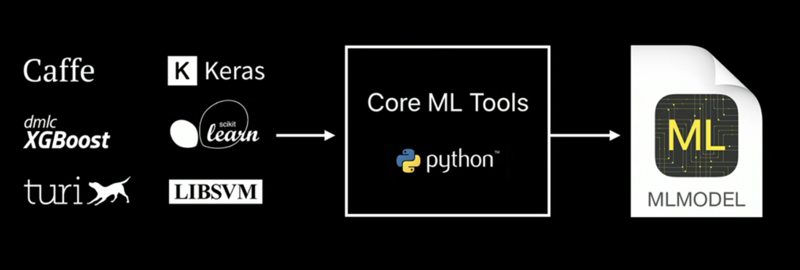
Tools to deploy ML Models on iOS
Microsoft Custom Vision API
Turi Create
CreateML
Coremltools
TF-CoreML
ONNX-CoreML
ML Kit
MMDNN

Slide 31
Tools to deploy a ML Model on Android
Microsoft Custom Vision API
TensorFlow TFLite Converter
ML Kit

Slide 32
Applications of ML on Mobile Phones
Apple’s Face ID for unlocking the phone, authentication etc.
Gmail and LinkedIn’s Smart Reply feature using LSTM on device.
Face Landmark detection for Facebook’s on-device Augmented Reality.
Google and Apple keyboard’s predictive text for messages, emails etc.
Activity Classification on Mobile Phones and Smart Watches.
Shazam for music discovery.
Image Segmentation with point clouds for Augmented Reality. ex. 6D.ai

Slide 33
Hands-On

Slide 34
Questions ??

